Slide 1
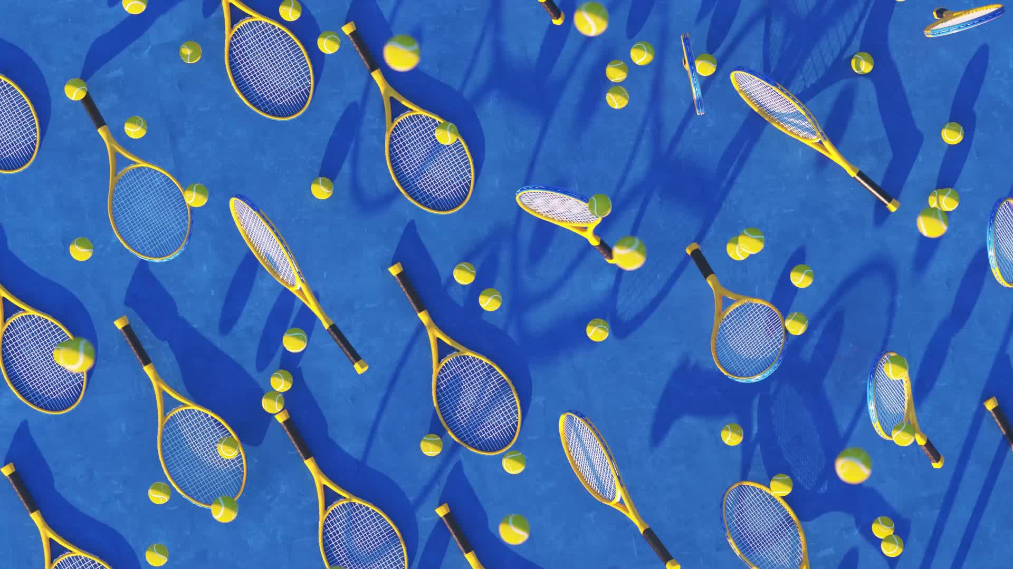
ATP Tennis Matches
Nick Ponticelli

Slide 2
Background
Data on 30 years of ATP Tennis matches
Provides sports performance insights
Provides sports betting (tennis) insights
Provides broadcasting talking points

Slide 3
Data Exploration
90,000+ Observations
49 features
32 Numerical
17 Categorical

Slide 4
Data Cleaning
No duplicate rows
Missing values replaced with Median, Max or Mode
Significant aggregation and rolling averages for statistics
Data transformed to randomize Player A and Player B in a match
Perfectly balanced data
Data is chronological, order of matches is important (prevent leakage)

Slide 5
Feature Engineering
Classification→ Match results (win/loss)
Regression→ Percentage of points won

Slide 6
Feature Engineering (Cont.)
Elo
Fatigue
Age
Height
Serve
Return
Rustiness
Match Length

Slide 7
Data Pre-Processing
Categorical variables one hot encoded
First 3,000 matches (chronological) discarded as ‘warm up period’
Data manually split chronologically 80-20
Numerical train variables standardized and fit to numerical test

Slide 8
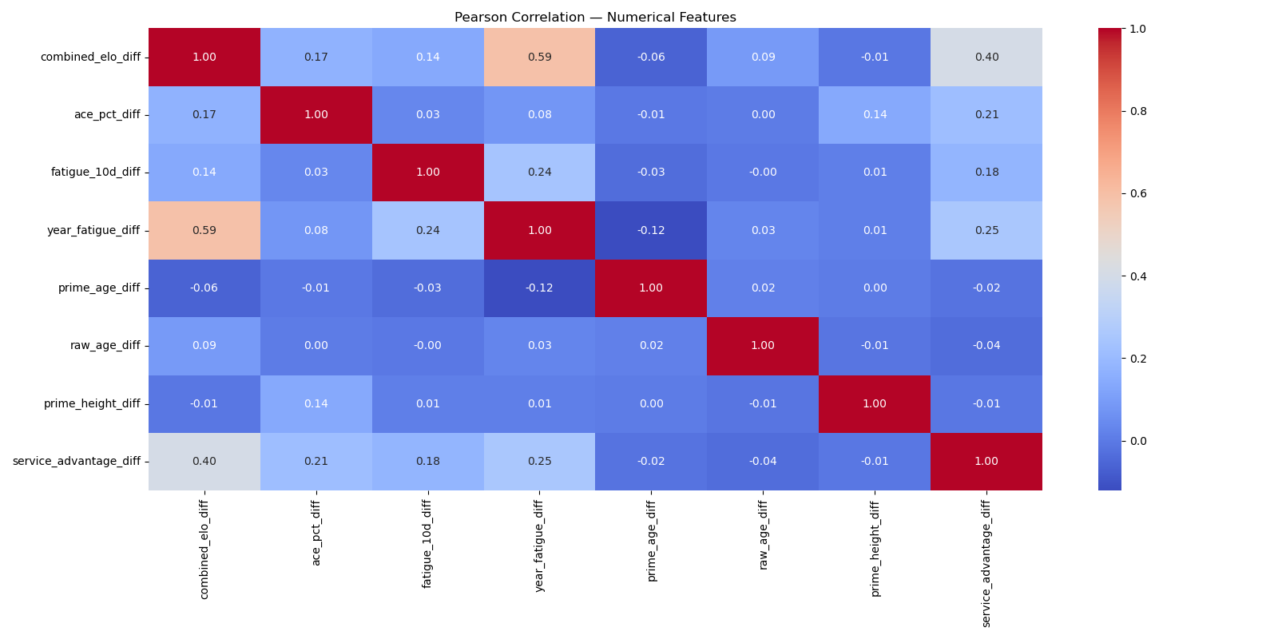
Pearson Correlation Heatmap

Slide 9
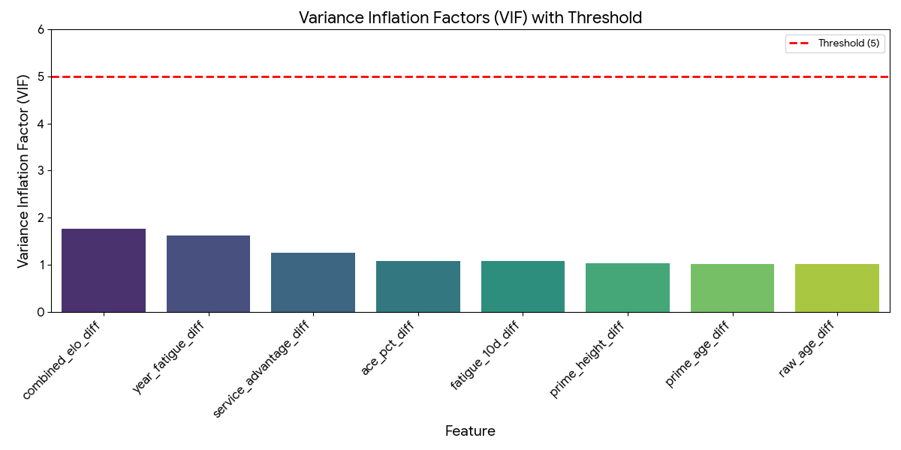
Variance Inflation Factors (VIF)

Slide 10
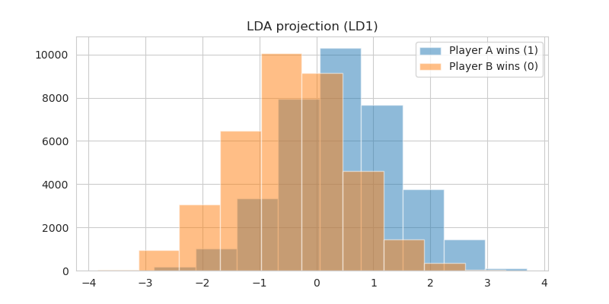
Linear Discriminant Analysis (LDA)

Slide 11
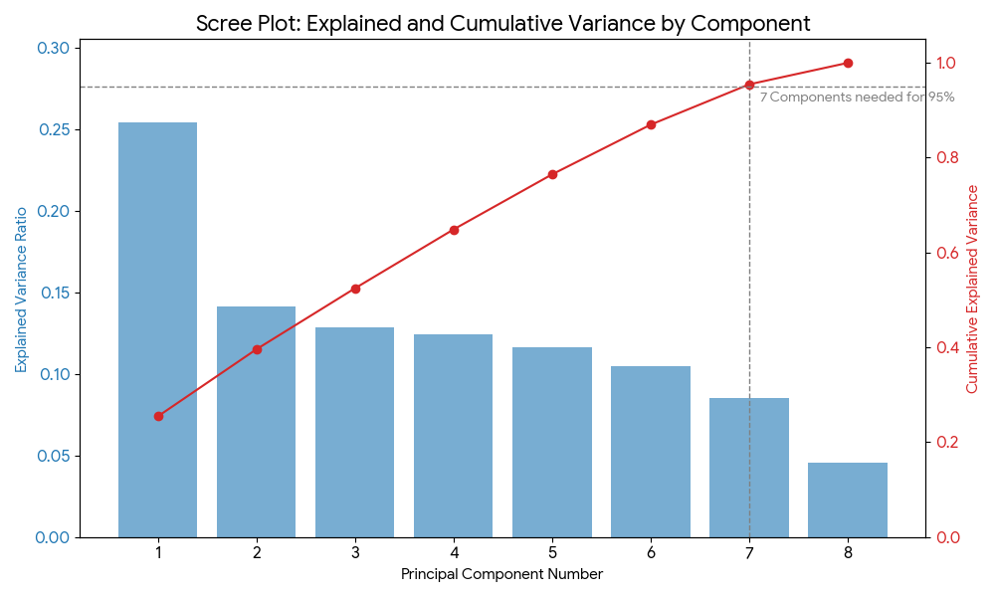
Singular Value Decomposition (SVD)

Slide 12
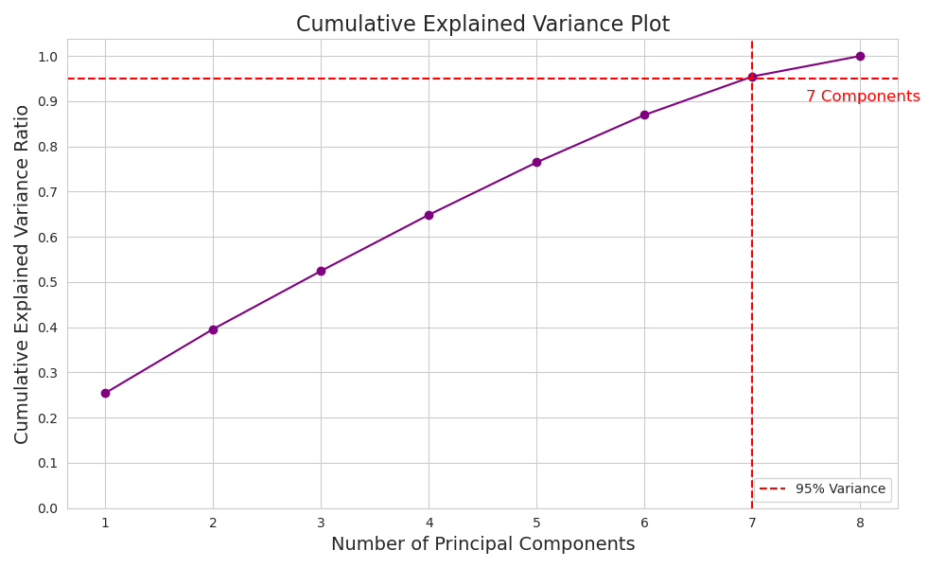
Principal Component Analysis (PCA)

Slide 13
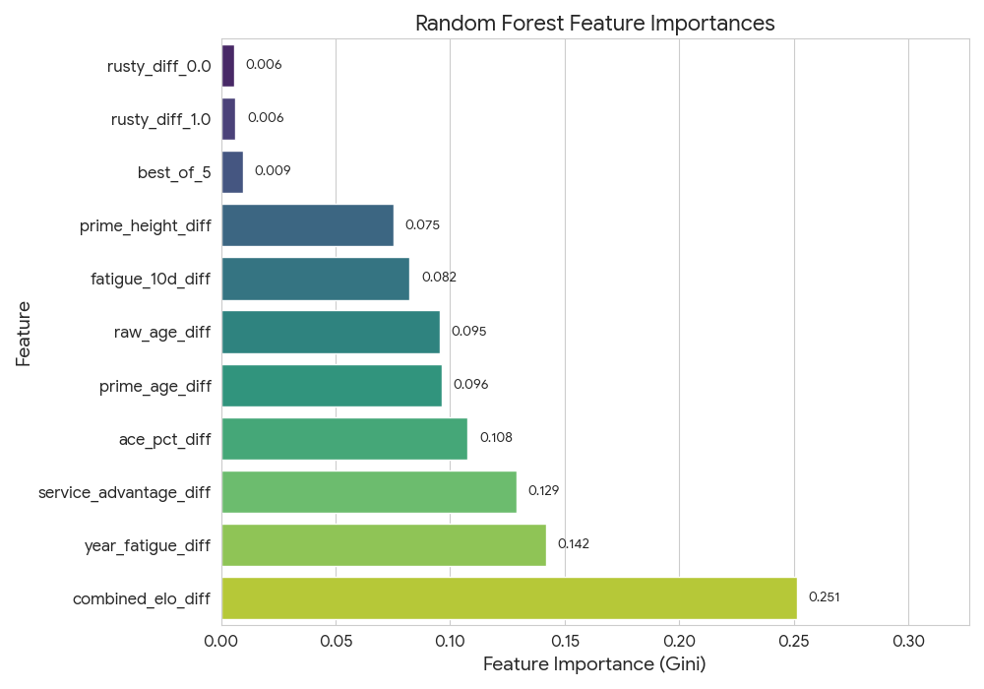
Random Forest Analysis

Slide 14
Chosen Technique
PCA
7 Features

Slide 15
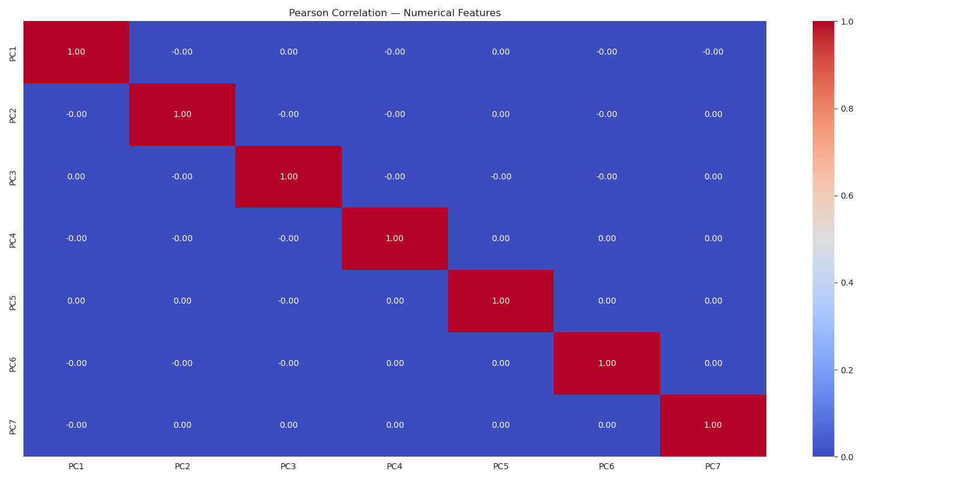
Post PCA Pearson Heatmap

Slide 16
Linear Regression

Slide 17
Classification
Win/Loss for a match
Player A wins → 1
Player B wins → 0
Key indicator → AUC

Slide 18
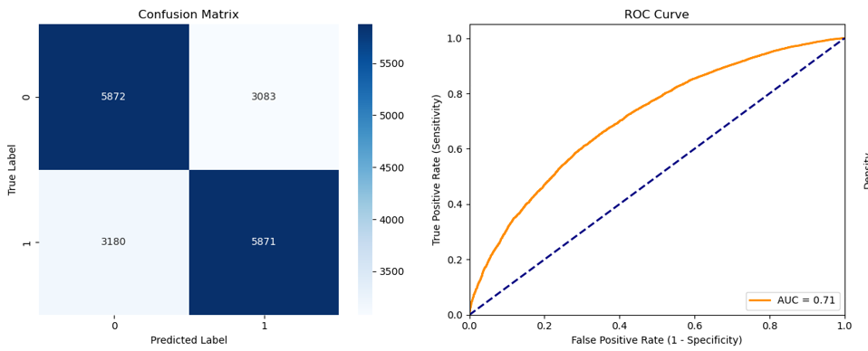
Classification - LDA
Classifier | Accuracy | AUC | F-Score | Precision | Recall (Sensitivity) | Specificity | Training Time (s) | Best Parameters
LDA | 0.6522 | 0.7095 | 0.6522 | 0.6557 | 0.6487 | 0.6557 | 0.21 | {'solver': 'svd'}

Slide 19
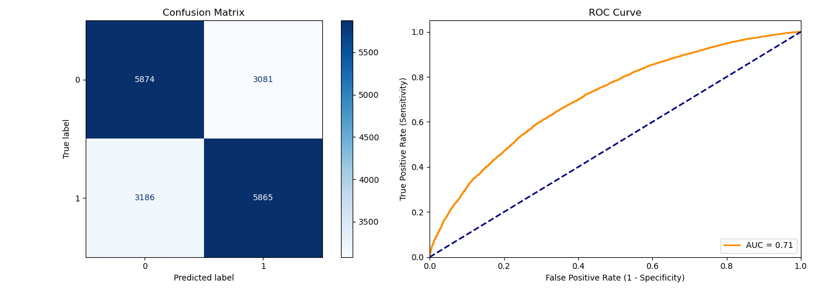
Classification – Logistic Regression
Classifier | Accuracy | AUC | F-Score | Precision | Recall (Sensitivity) | Specificity | Training Time (s) | Best Parameters
Logistic Regression | 0.6519 | 0.7095 | 0.6518 | 0.6556 | 0.648 | 0.6559 | 1 | {'C': 10.0, 'penalty': 'l1'}

Slide 20
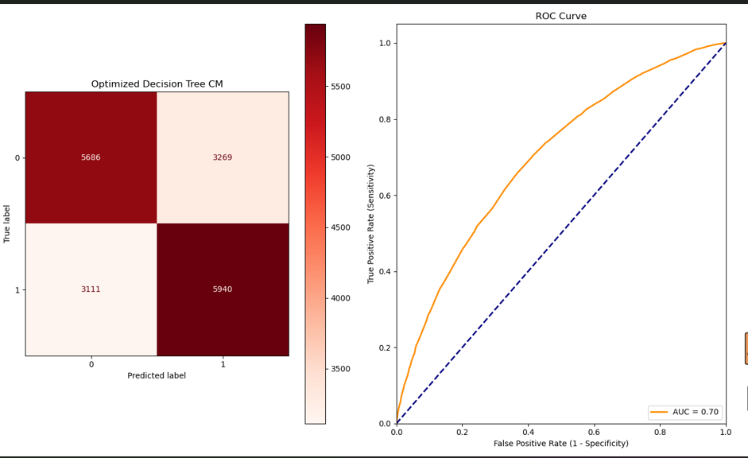
Classification - Decision Tree
Classifier | Accuracy | AUC | F-Score | Precision | Recall (Sensitivity) | Specificity | Training Time (s) | Best Parameters
Decision Tree | 0.6457 | 0.698 | 0.6506 | 0.645 | 0.6563 | 0.635 | 8.41 | {'max_depth': 7, 'min_samples_leaf': 10, 'criterion': 'entropy', ...}

Slide 21
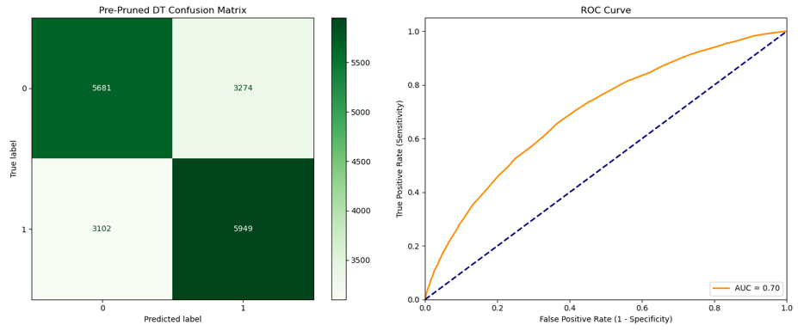
Classification – Pre-Pruned Decision Tree
Classifier | Accuracy | AUC | F-Score | Precision | Recall (Sensitivity) | Specificity | Training Time (s) | Best Parameters
Pre-Pruned DT | 0.6459 | 0.6979 | 0.6511 | 0.645 | 0.6573 | 0.6344 | 19.6 | {'max_depth': 7, 'min_samples_leaf': 30, 'criterion': 'entropy', ...}

Slide 22
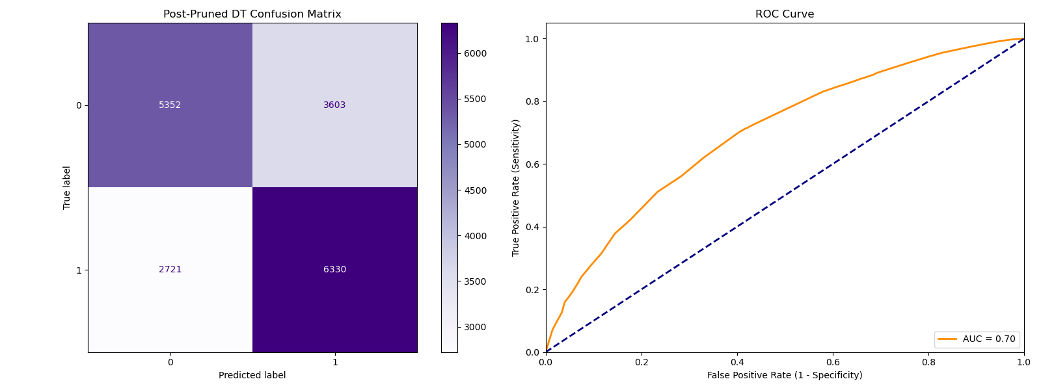
Classification – Post-Prune Decision Tree
Classifier | Accuracy | AUC | F-Score | Precision | Recall (Sensitivity) | Specificity | Training Time (s) | Best Parameters
Post-Pruned DT (CCP) | 0.6488 | 0.6996 | 0.6669 | 0.6373 | 0.6994 | 0.5977 | 5432.69 | {'ccp_alpha': 0.000108}

Slide 23
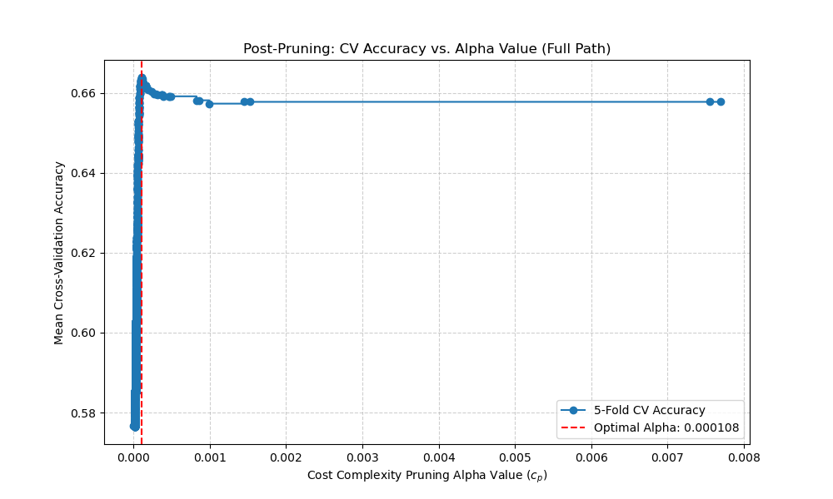
Classification – Post-Prune Decision Tree

Slide 24
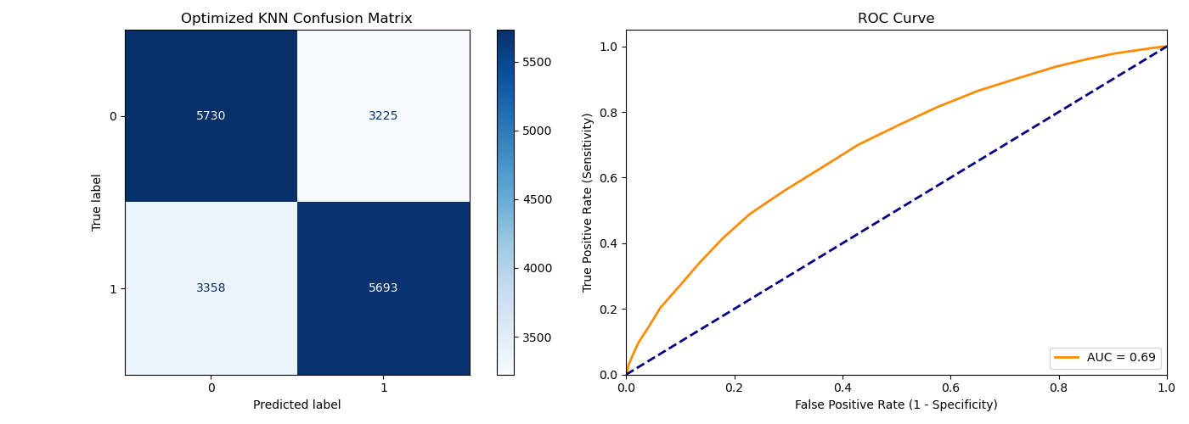
Classification – KNN
Classifier | Accuracy | AUC | F-Score | Precision | Recall (Sensitivity) | Specificity | Training Time (s) | Best Parameters
KNN | 0.6344 | 0.6892 | 0.6336 | 0.6384 | 0.629 | 0.6399 | 38.02 | {'n_neighbors': 25, 'metric': 'manhattan', 'weights': 'uniform'}

Slide 25
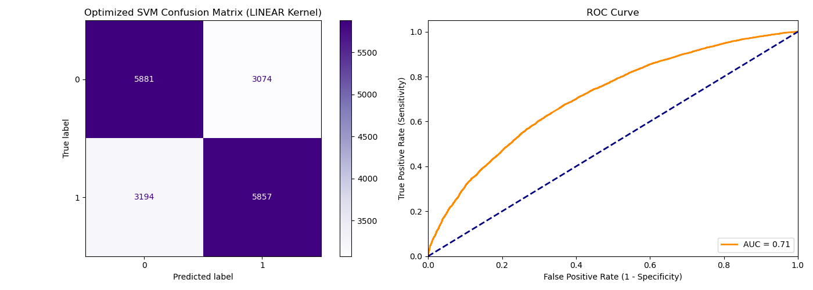
Classification – SVM
Classifier | Accuracy | AUC | F-Score | Precision | Recall (Sensitivity) | Specificity | Training Time (s) | Best Parameters
SVM (Linear) | 0.6519 | 0.7094 | 0.6514 | 0.6558 | 0.6471 | 0.6567 | 6833.38 | {'kernel': 'linear', 'C': 0.1}

Slide 26
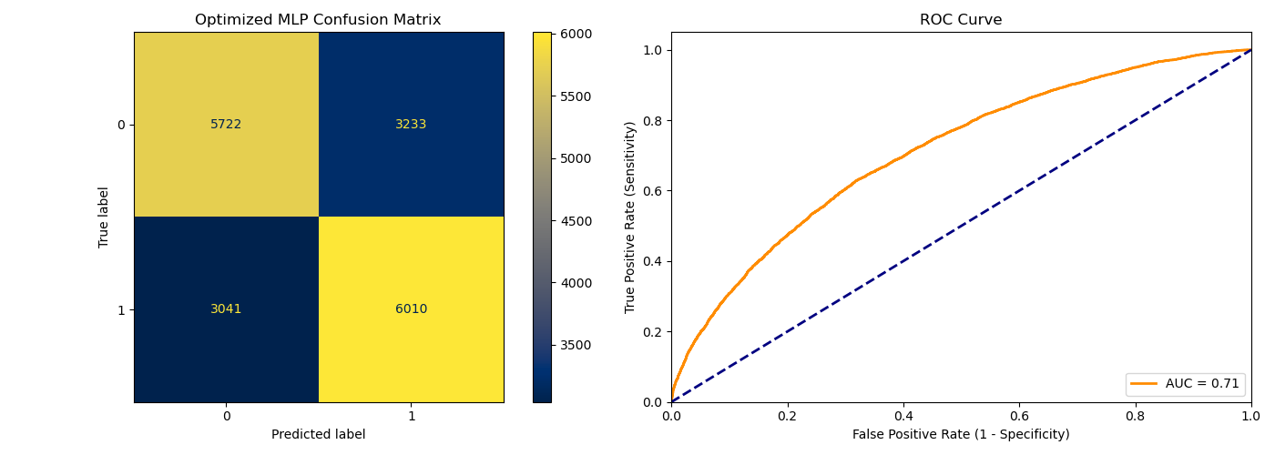
Classification – Neural Network
Classifier | Accuracy | AUC | F-Score | Precision | Recall (Sensitivity) | Specificity | Training Time (s) | Best Parameters
MLP Neural Network | 0.6516 | 0.7105 | 0.657 | 0.6502 | 0.664 | 0.639 | 216.29 | {'hidden_layer_sizes': (50,), 'alpha': 0.1, 'activation': 'relu', ...}

Slide 27
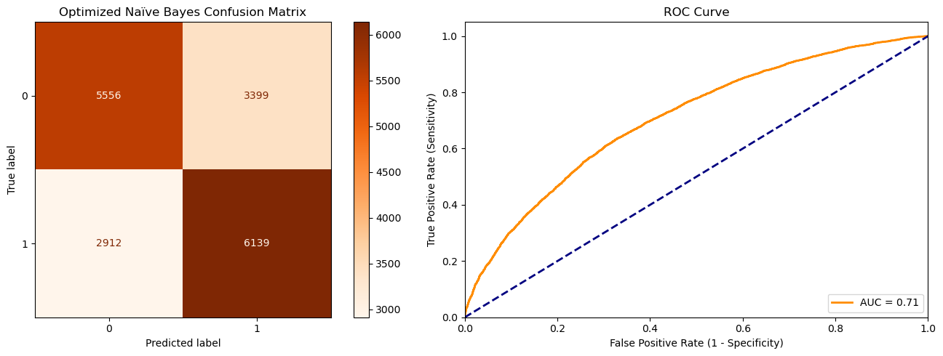
Classification – Naïve Bayes
Classifier | Accuracy | AUC | F-Score | Precision | Recall (Sensitivity) | Specificity | Training Time (s) | Best Parameters
Naïve Bayes | 0.6495 | 0.7072 | 0.6605 | 0.6436 | 0.6783 | 0.6204 | 1.65 | {'var_smoothing': 0.1233}

Slide 28
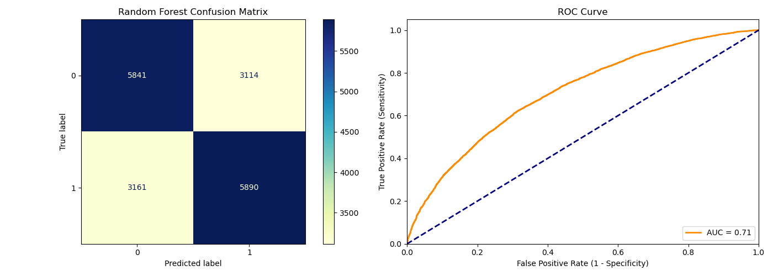
Classification – Random Forest
Classifier | Accuracy | AUC | F-Score | Precision | Recall (Sensitivity) | Specificity | Training Time (s) | Best Parameters
Random Forest | 0.6515 | 0.7091 | 0.6525 | 0.6542 | 0.6508 | 0.6523 | 528.03 | {'n_estimators': 100, 'max_depth': 10, 'max_features': 'log2', ...}

Slide 29
All Results
Rank | Classifier | Accuracy | AUC | F-Score | Precision | Recall (Sensitivity) | Specificity | Training Time (s)
1 | MLP Neural Network | 0.6516 | 0.7105 | 0.657 | 0.6502 | 0.664 | 0.639 | 216.29
2 | Logistic Regression | 0.6519 | 0.7095 | 0.6518 | 0.6556 | 0.648 | 0.6559 | 1
3 | LDA | 0.6522 | 0.7095 | 0.6522 | 0.6557 | 0.6487 | 0.6557 | 0.21
4 | SVM (Linear) | 0.6519 | 0.7094 | 0.6514 | 0.6558 | 0.6471 | 0.6567 | 6833.38
5 | Random Forest | 0.6515 | 0.7091 | 0.6525 | 0.6542 | 0.6508 | 0.6523 | 528.03
6 | Naïve Bayes | 0.6495 | 0.7072 | 0.6605 | 0.6436 | 0.6783 | 0.6204 | 1.65
7 | Post-Pruned DT (CCP) | 0.6488 | 0.6996 | 0.6669 | 0.6373 | 0.6994 | 0.5977 | 5432.69
8 | Decision Tree | 0.6457 | 0.698 | 0.6506 | 0.645 | 0.6563 | 0.635 | 8.41
9 | Pre-Pruned DT | 0.6459 | 0.6979 | 0.6511 | 0.645 | 0.6573 | 0.6344 | 19.6
10 | KNN | 0.6344 | 0.6892 | 0.6336 | 0.6384 | 0.629 | 0.6399 | 38.02

Slide 30
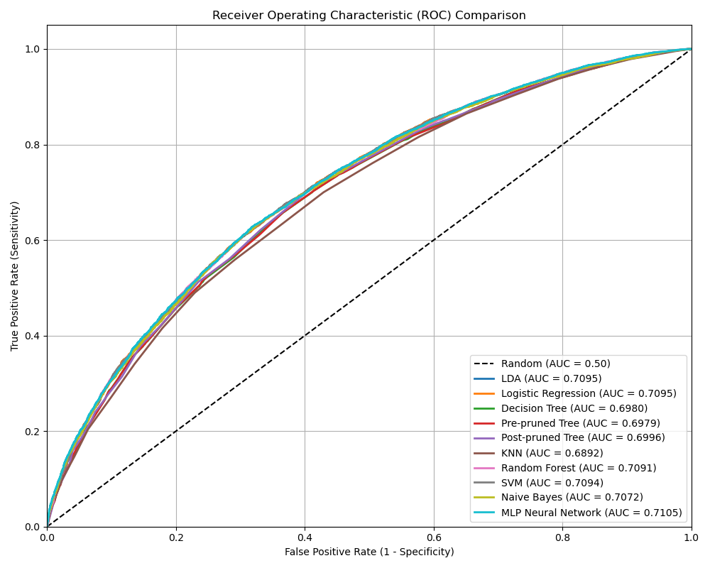
All AUC

Slide 31
Clustering
Find subsets of matches in the dataset
Useful to see how model performs on various groups

Slide 32
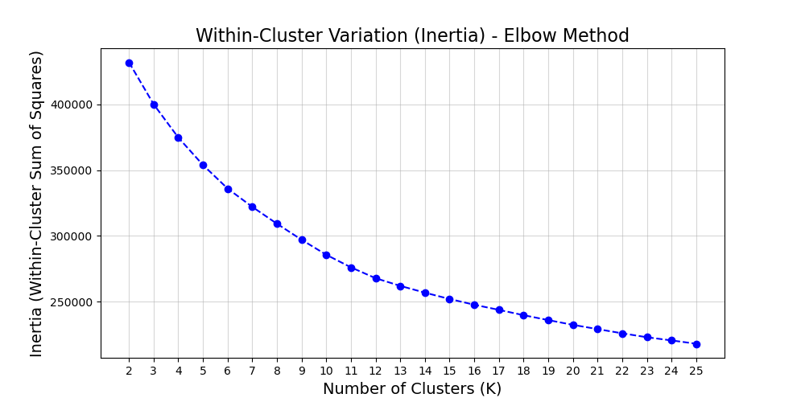
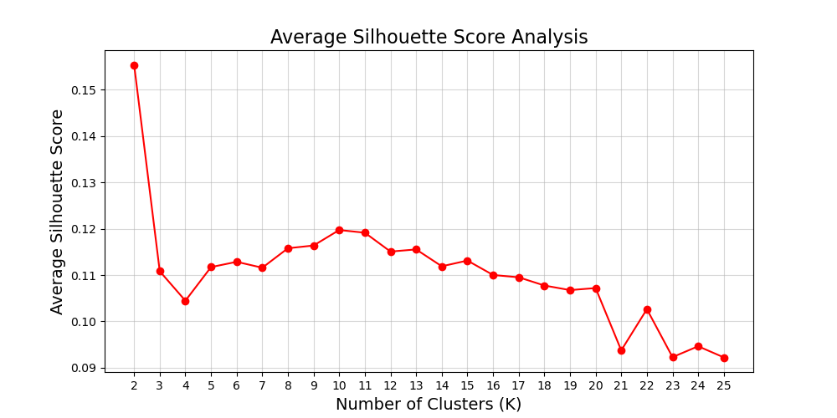
Clustering

Slide 33
Improvements
Rolling average for linear regression
More features
Head-to-head, momentum, historic tournament win percentage
More feature interaction
Fatigue and age interaction

